Slide 1



Introduction to BOOST
By Sanjay and Arvind Seshan

Slide 2
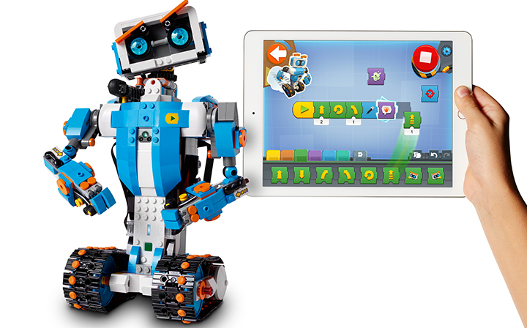
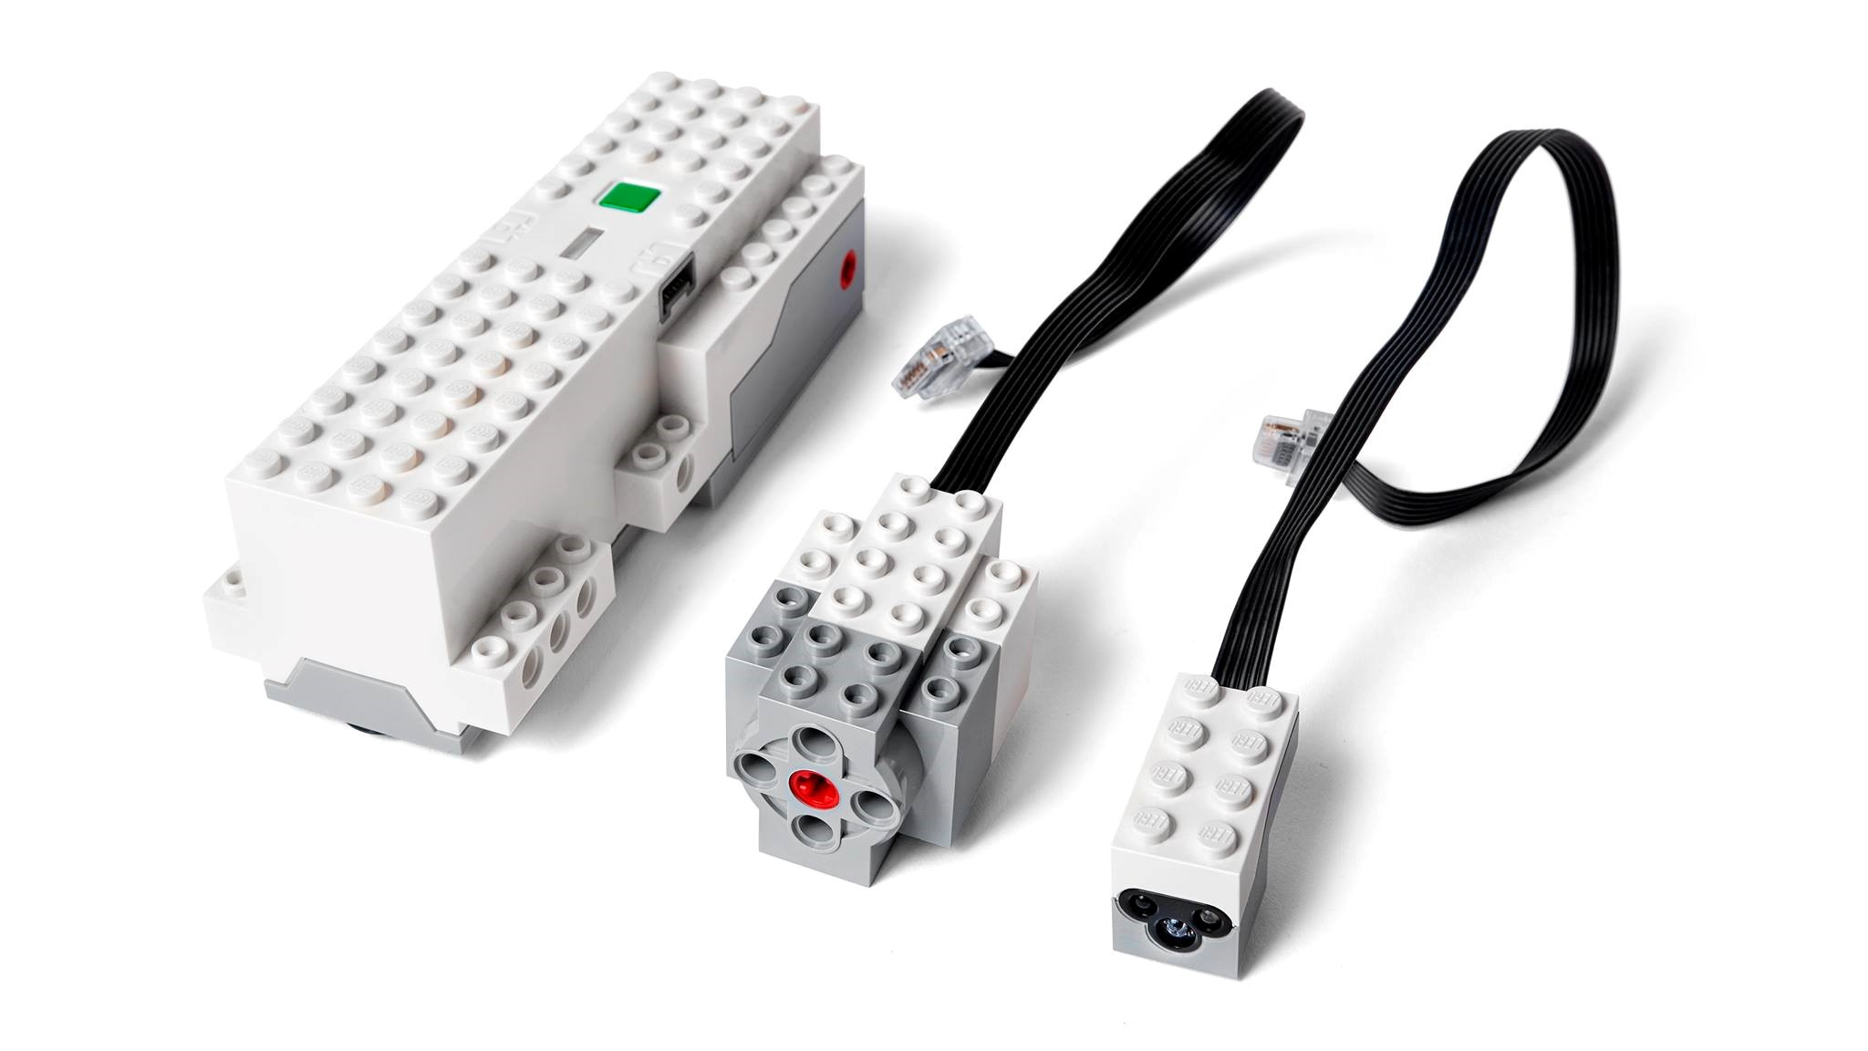
About Boost
What is BOOST?
BOOST Creative Toolbox is a new product by LEGO(R) is for ages 7 and up. Like MINDSTORMS, BOOST has a programmable Hub, which connects via Bluetooth LE to a tablet (iOS/Android).
Your kit comes with the following electronics:
Move Hub (With 2 encoded motors)
1 Additional Encoded Motor
1 Color/Distance Sensor Combination
It also includes:
1 Poster
Playmat for Testing Programs
844 Extra LEGO Brick Assortment
You will need 6 AAA batteries to power the BOOST
Image Credit: LEGO

Slide 3
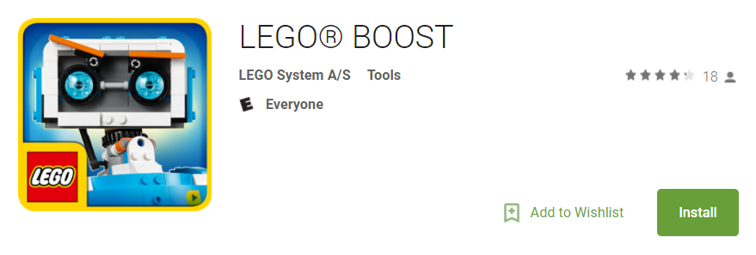
Installing the Software
The BOOST only supports Android 5.1.1+ and iOS 10+ Tablets (as of 2017)
To download the app, click on the links below:
Android: https://play.google.com/store/apps/details?id=com.lego.boost.boost#xlink
iOS: https://itunes.apple.com/app/lego-boost/id1217385613#xlink
If you are using a PC/Mac, you can try this project: http://www.android-x86.org/ to install the app.

Slide 4
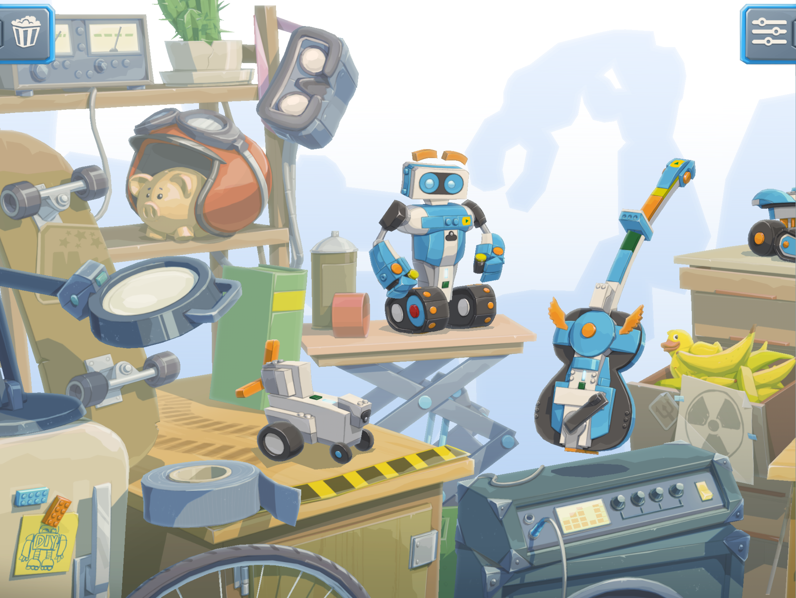
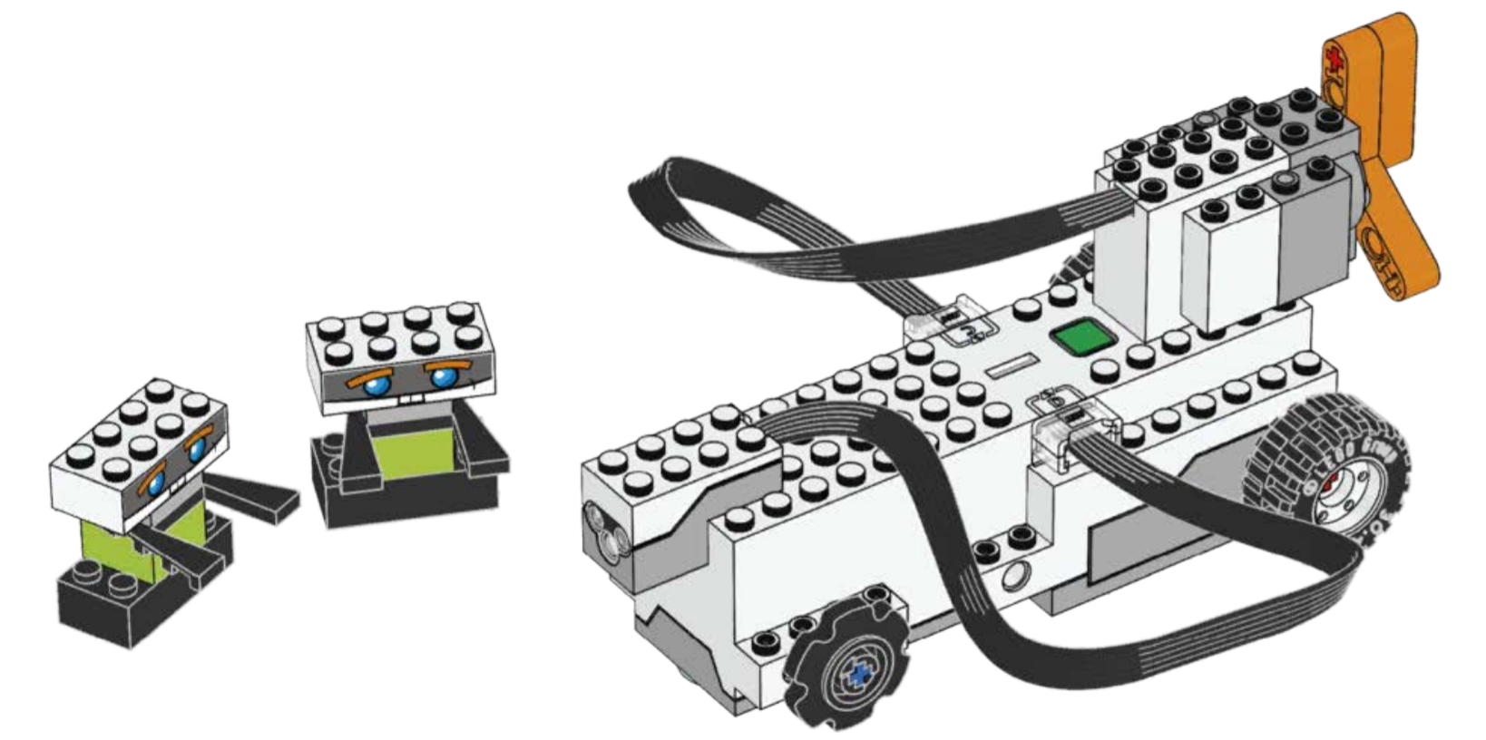
Build your Robot
The App contains the Build Instructions for each of the models
Start by building the “Getting Started Vehicle” and then proceed through the levels.
Alternatively, you can use the PDF instructions available here: http://www.boostlessons.com/robots.html (Thank you Danny's LAB for extracting the build instructions)
Image Credit: LEGO

Slide 5
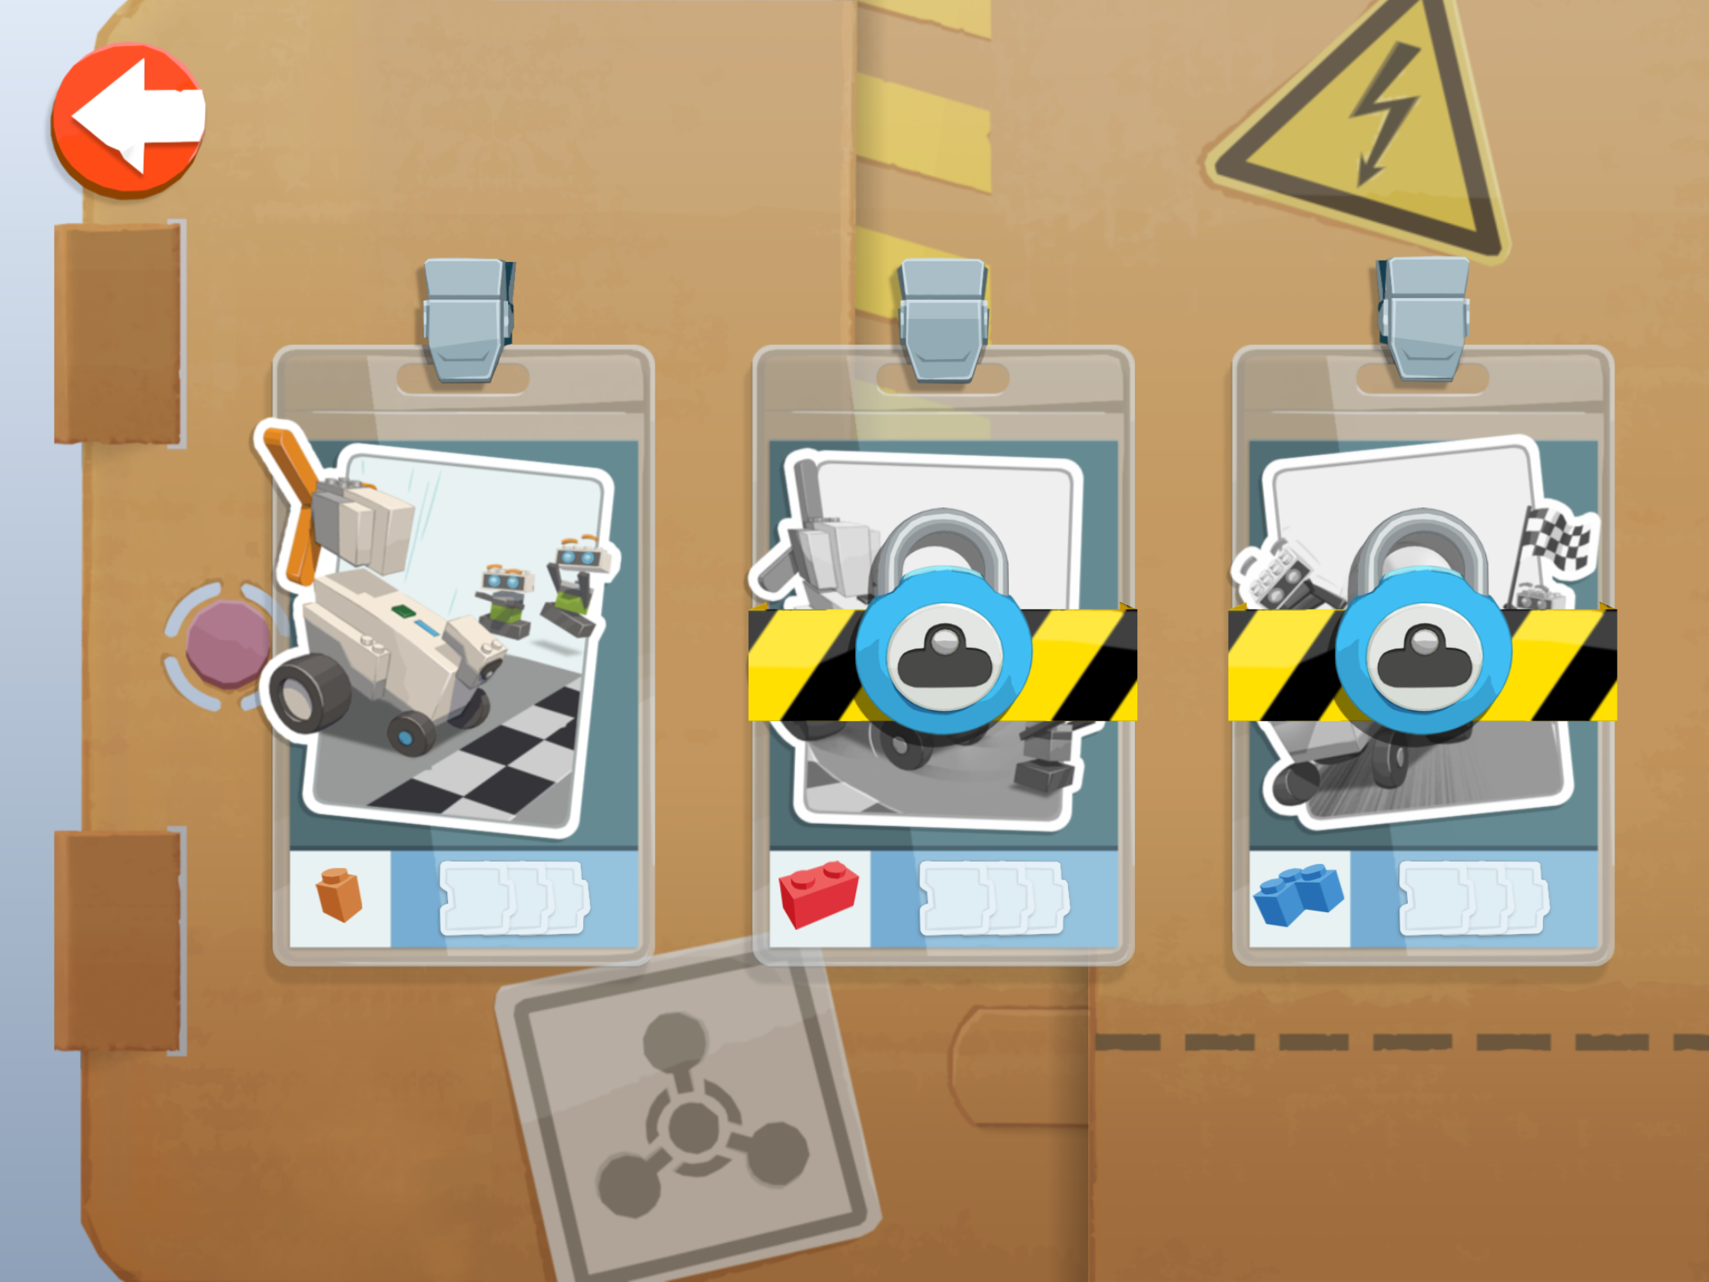
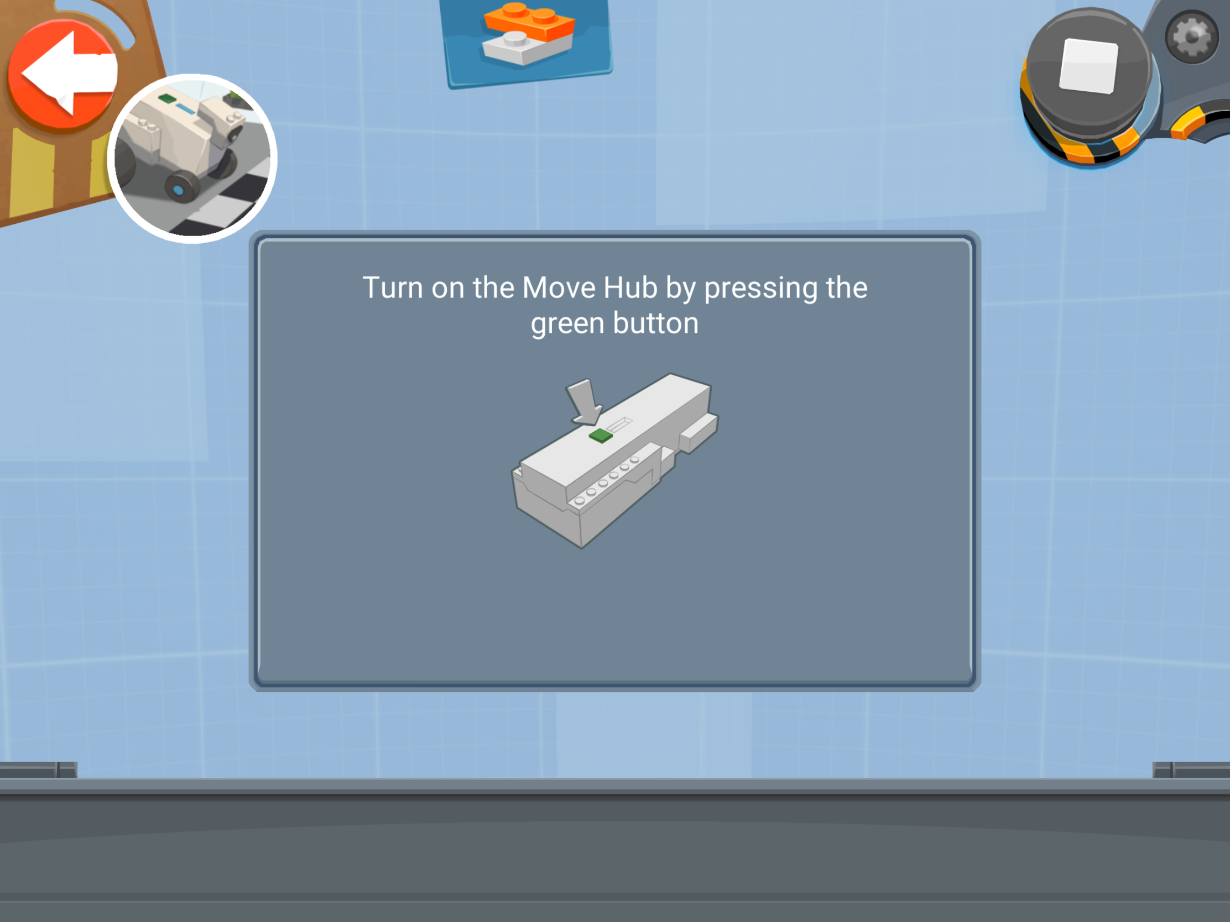
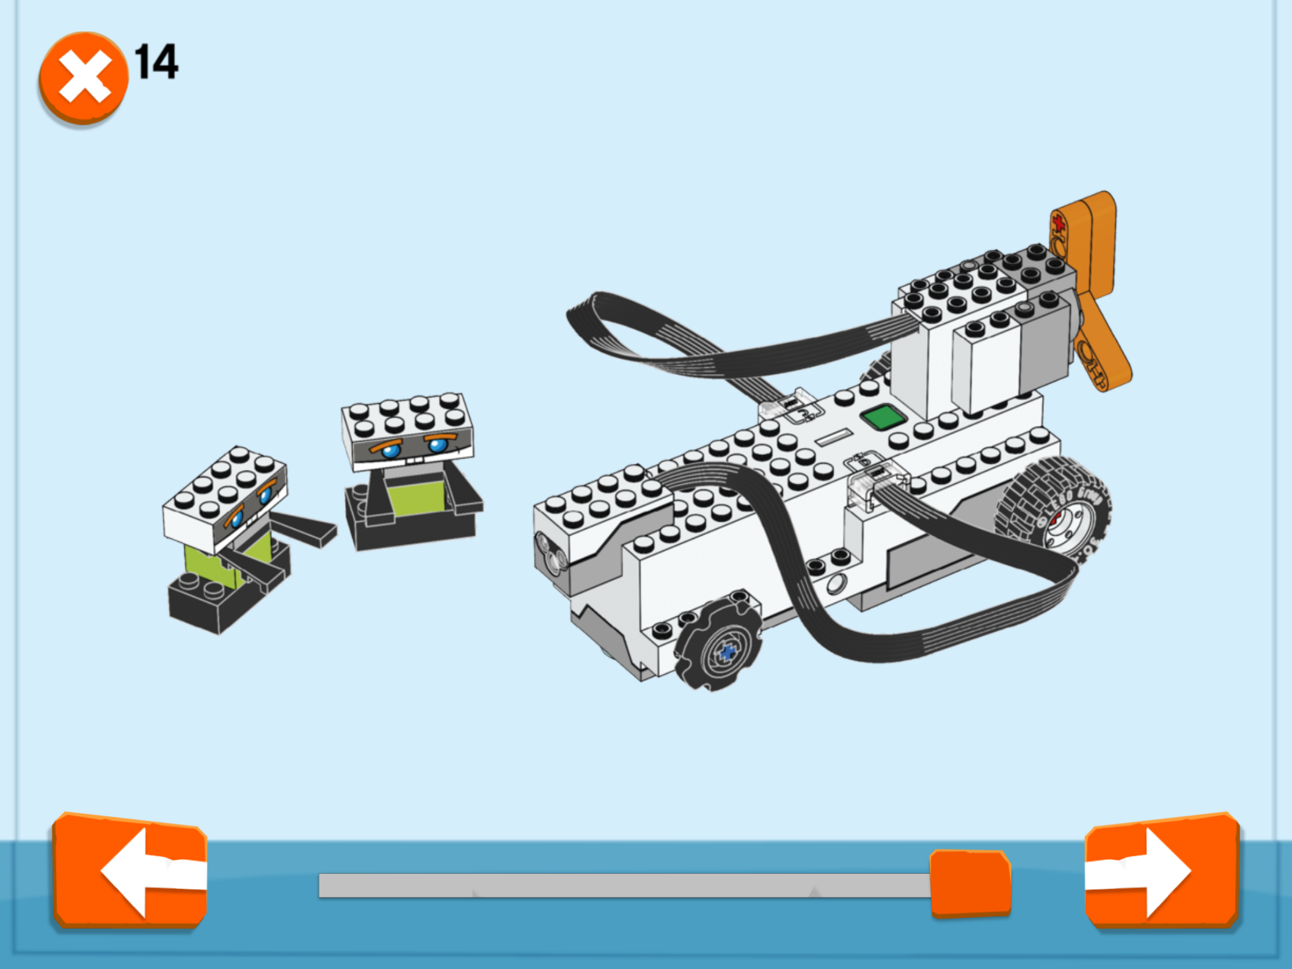
Connect to your BOOST
Click on your robot
Select the first option
Press the green button on the hub
Build your robot, or if you already have built one, skip to the last page. Click next.

Slide 6
Now you are ready to start programming!

Slide 7
Credits
Lesson by Sanjay and Arvind Seshan
This work is licensed under a Creative Commons Attribution-NonCommercial-ShareAlike 4.0 International License.
Photo Credit: LEGO

